Slide 1

EMG Spike sorting
Martin Bourdev
December 10, 2023

Slide 2
outline
Introduction
Methods
What is EMG?
In Practice
Filtering
Spike Detection and Alignment
Clustering
Results
Analysis
Classification
Illustrations
Discussion
Potential Improvements

Slide 3
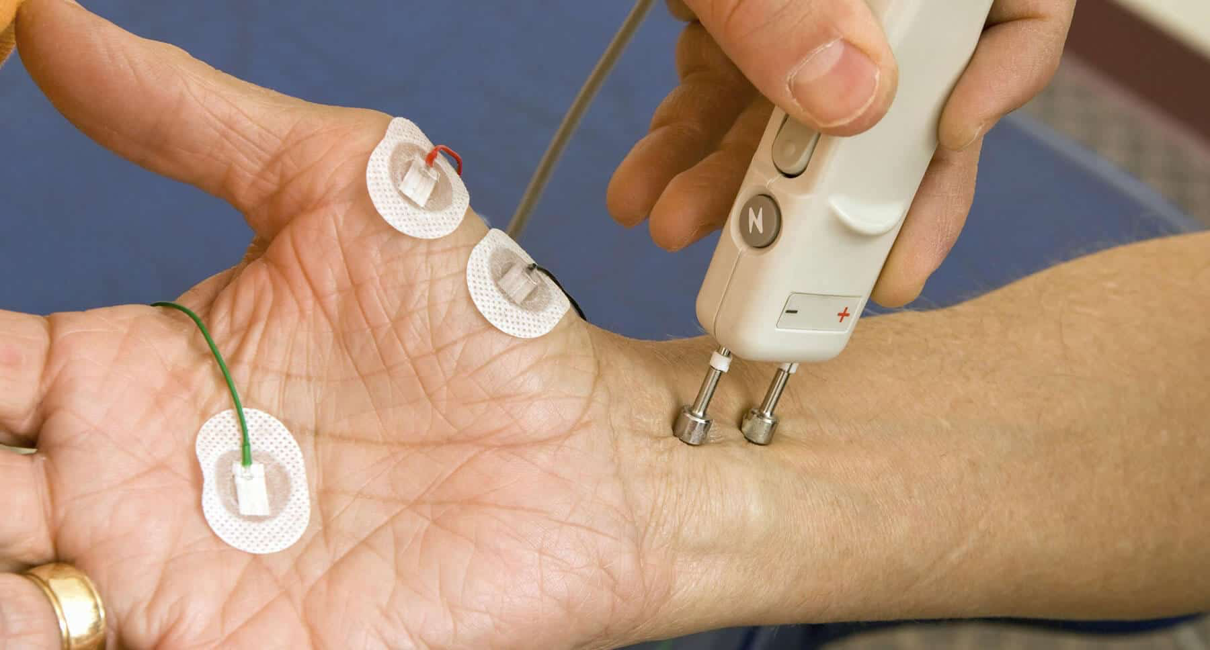
Introduction

Slide 4
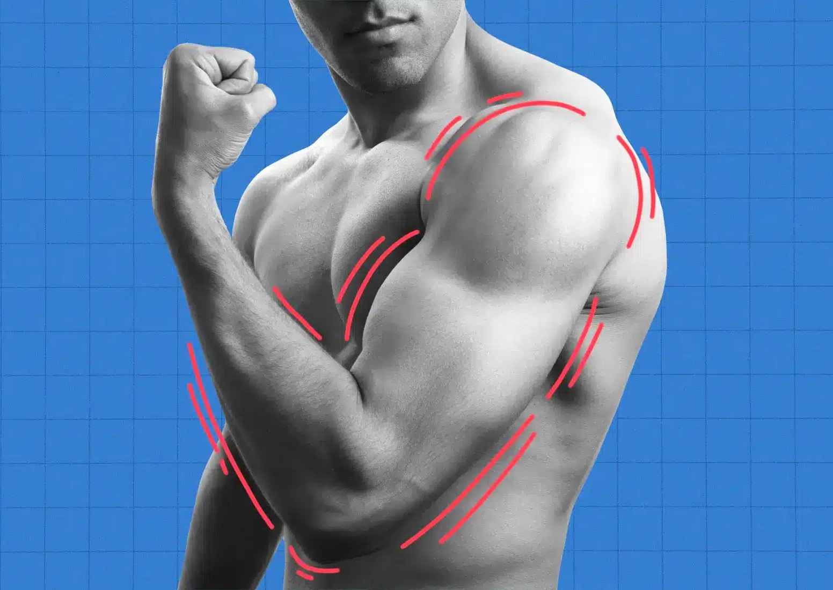
What is emg?
Aggregation of motor unit action potentials (MUAPs)
MUAPs: sums of action potentials of individual muscle fibers of one motor unit
Known as muscle fiber action potential (MFAP)
Goal: Classify MUAPs into different motor units based on sizes and shapes.

Slide 5
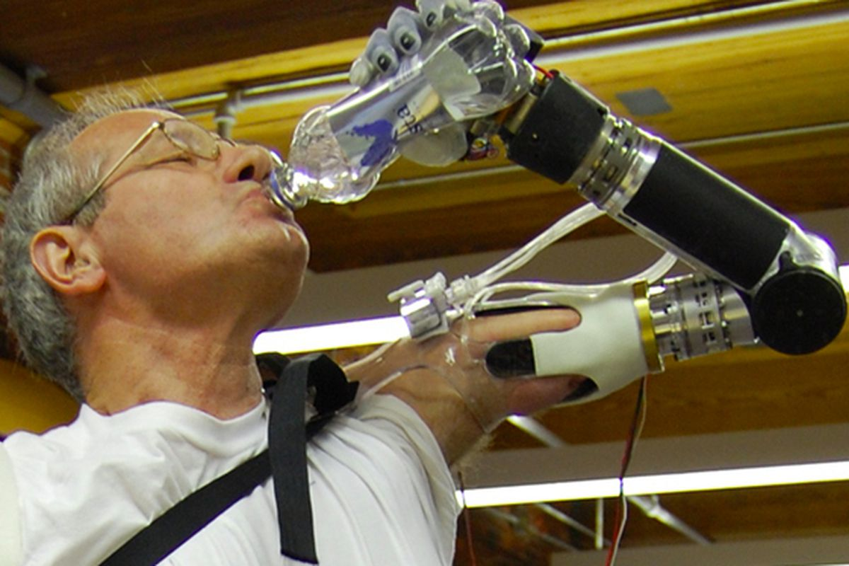
In practice
Data Collection
Clinical Use
Electrodes collect data from many motor neurons
Most MUAPs are too small to distinguish
Smaller electrodes provide more resolution
Calculate frequencies of each motor neuron
Decode patient actions from frequencies
Build prosthetics controlled by muscles

Slide 6

Methods (channel 2)

Slide 7



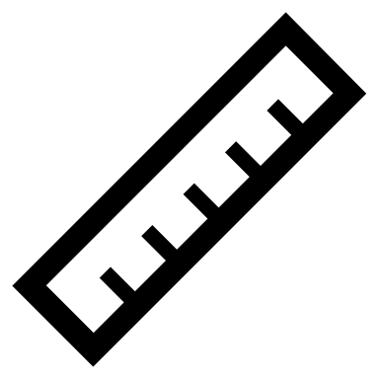
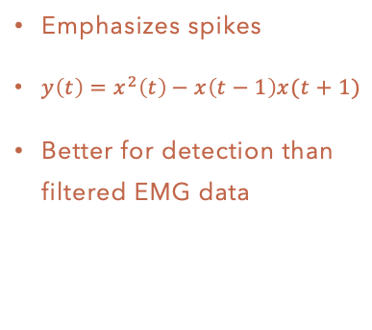
Data preprocessing
Loading Data
Filtering Data
Nonlinear Energy Operator
Spike Detection
Use Python numpy library
Sampling rate: 2000 Hz
40001 data points
Two channels
scipy Butterworth filter
100 Hz to 999 Hz
Filter out low frequency noise, centers data
Chosen from literature review
Emphasizes spikes
$y\left(t\right)=x^{2}\left(t\right)−x\left(t−1\right)x(t+1)$
Better for detection than filtered EMG data
Determine amplitude threshold from NEO
Exclude points that are too close to each other to avoid double-counting
Calculate indices of spike peaks

Slide 8
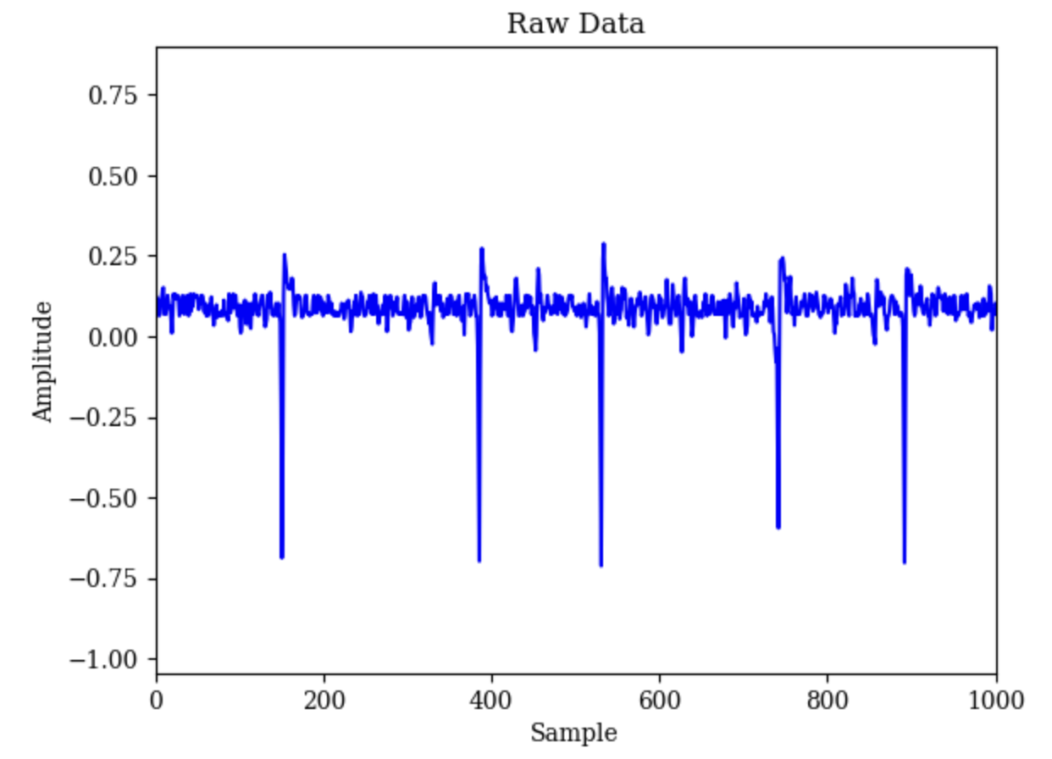
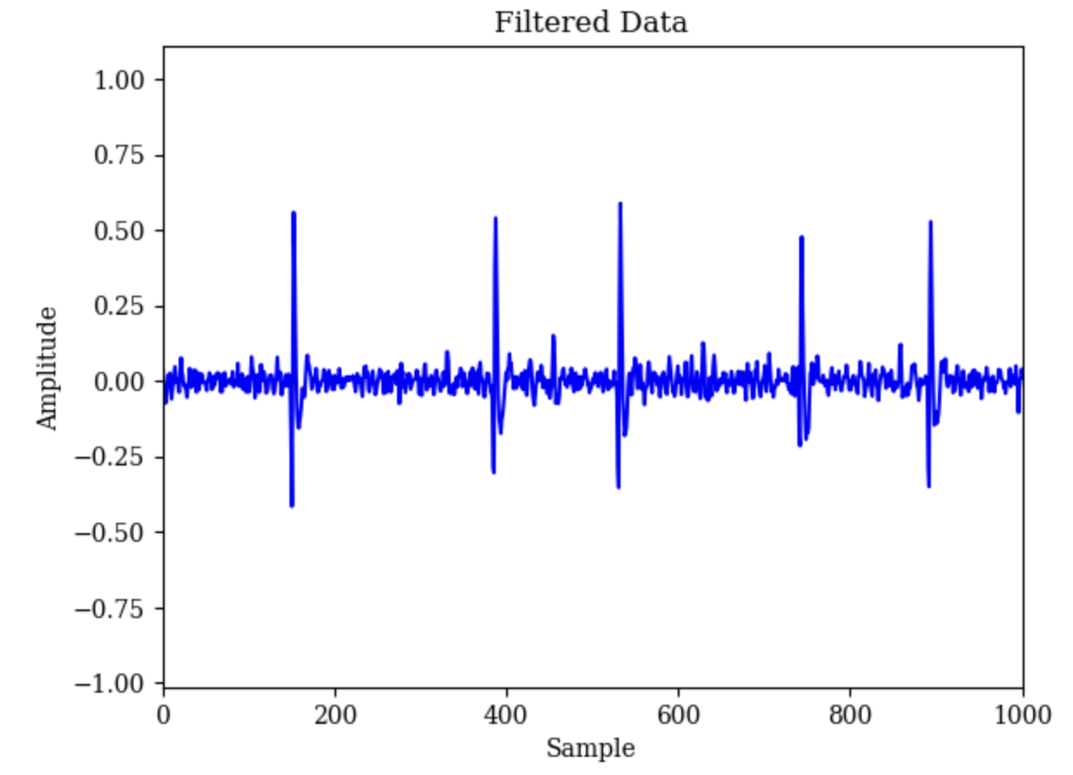
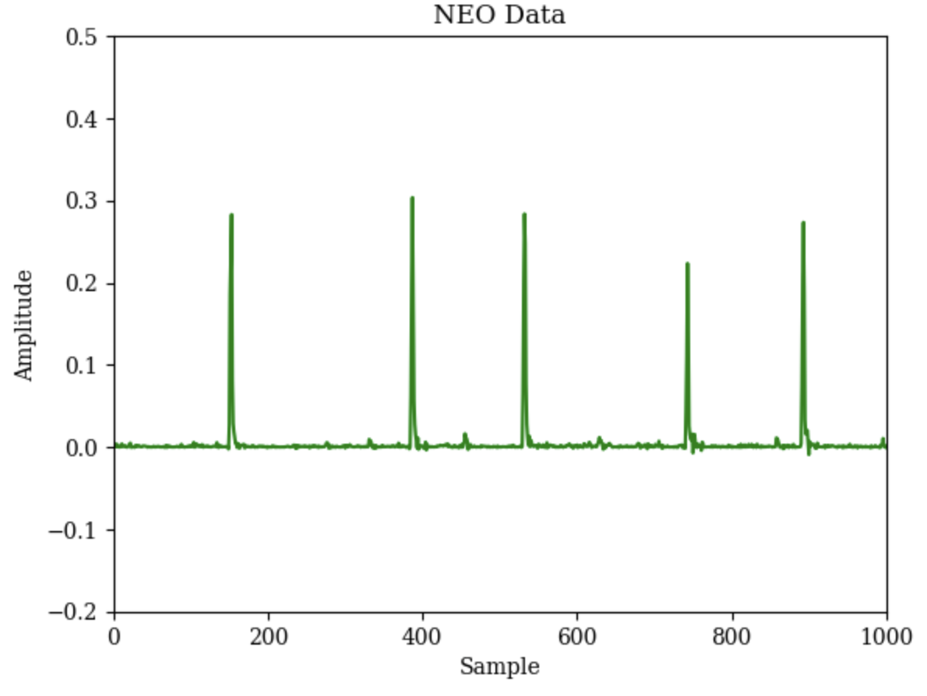
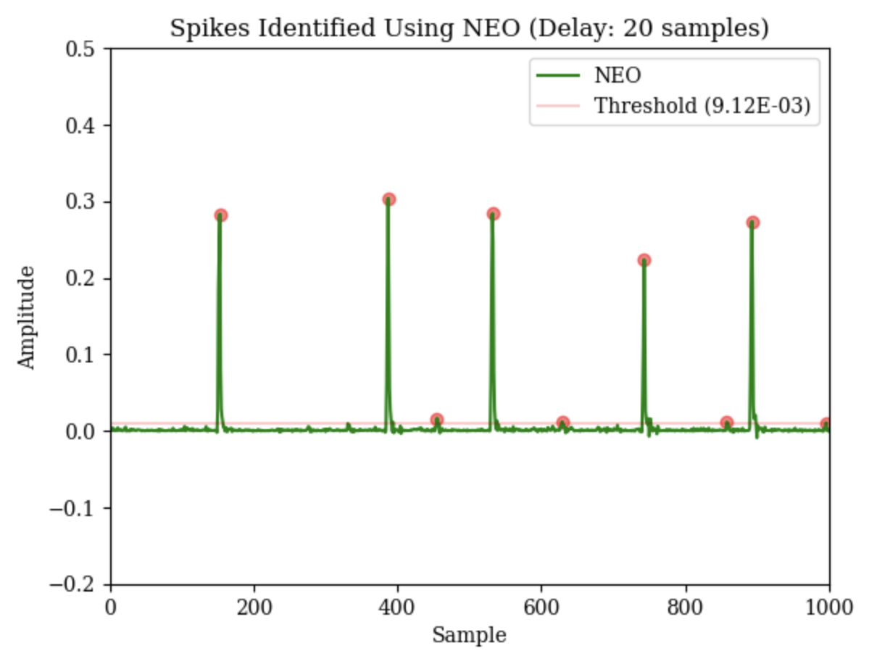
Data preprocessing
Loading Data
Filtering Data
Nonlinear Energy Operator
Spike Detection

Slide 9
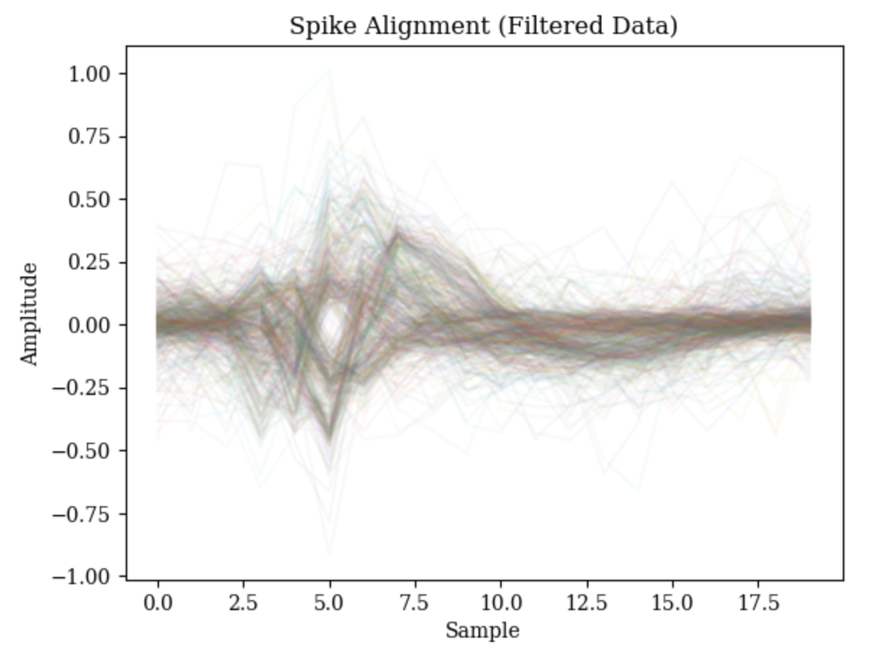
Spike alignment
Methods
Usage
Find the local maximum of identified spikes
Align them with 5 data points to the left and 15 data points to the right
Large potential for error due to misalignment
Construct 20—dimensional matrix of spike data
Compress using PCA
Cluster and classify spikes based on waveform

Slide 10
PCA clustering
K-Means
Agglomerative
Style
Determining K
Process
Style
Determining K
Process
Top-Down
Divide clusters using straight lines
Elbow method
Inertia metric
Randomly assign k centroids
Assign data to clusters
Update centroids, repeat
Bottom-Up
No clear cluster boundaries
View dendrogram
Track distance between cluster steps
Assign each point to its own cluster
Combine two closest clusters
Repeat until one cluster

Slide 11
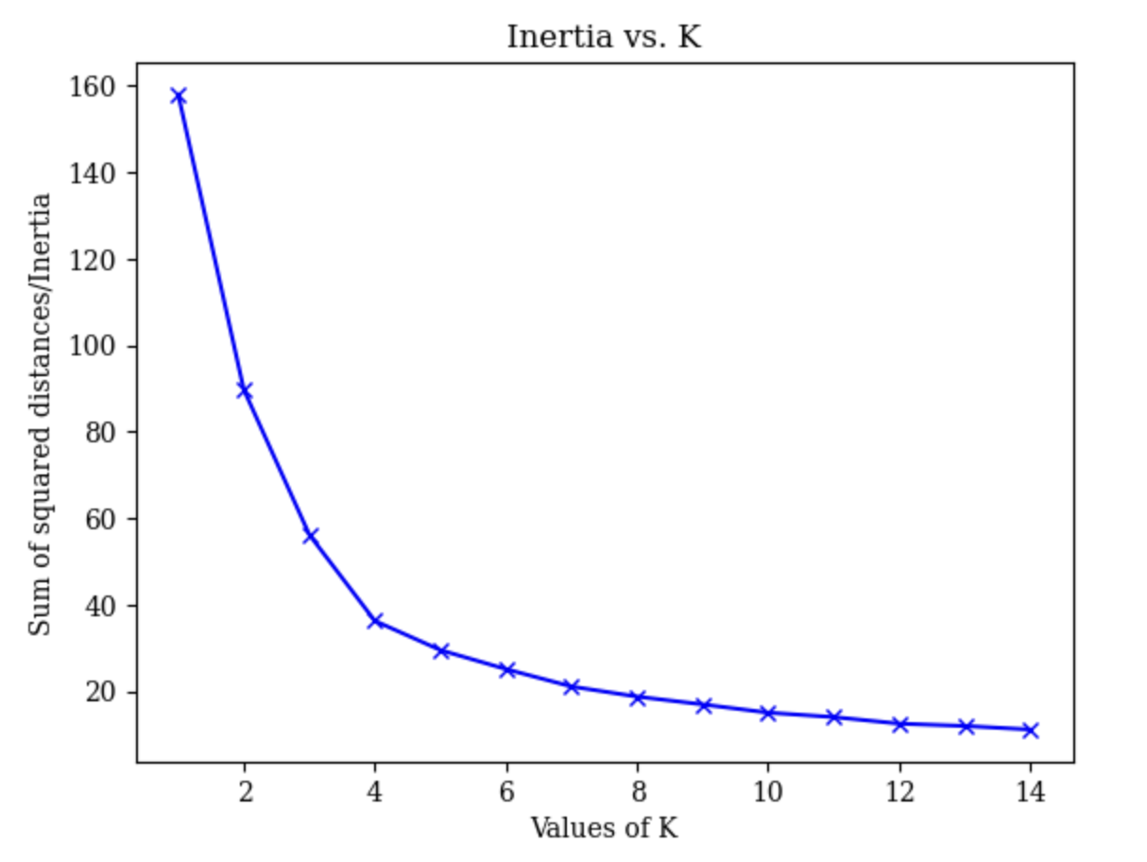
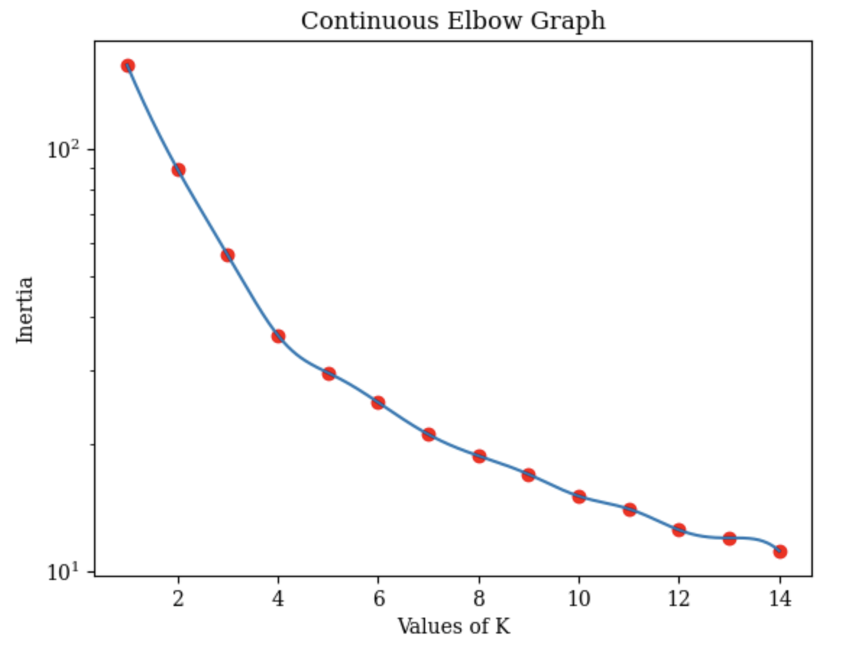
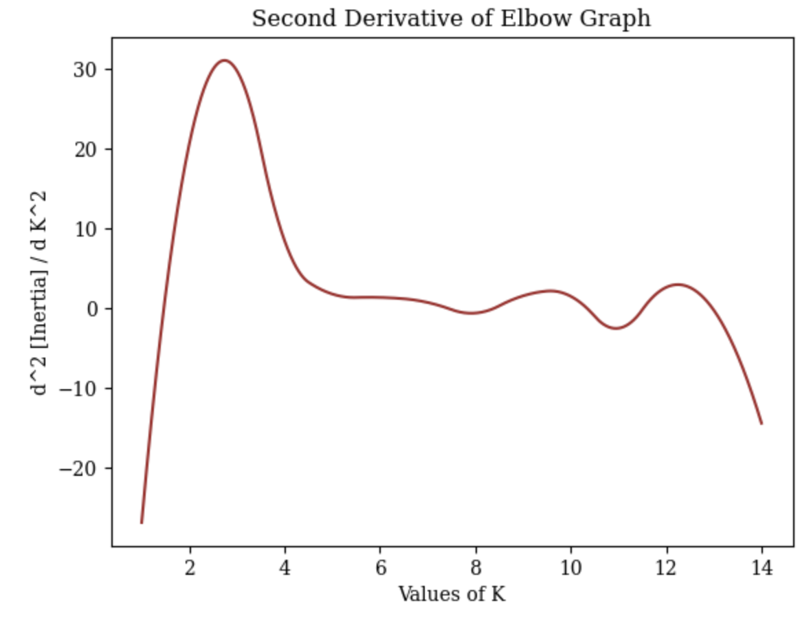
Determining K (K-Means)
What is inertia?
Determining k
Inertia: average squared distance between points to centroid
Will always decrease with number of clusters
Must balance with number of clusters
Plot inertia vs. k (elbow graph)
Make continuous, take second derivative
Find peak of the second derivative, indicating inflection point (best tradeoff between inertia and k)
In this case, k = 4.

Slide 12
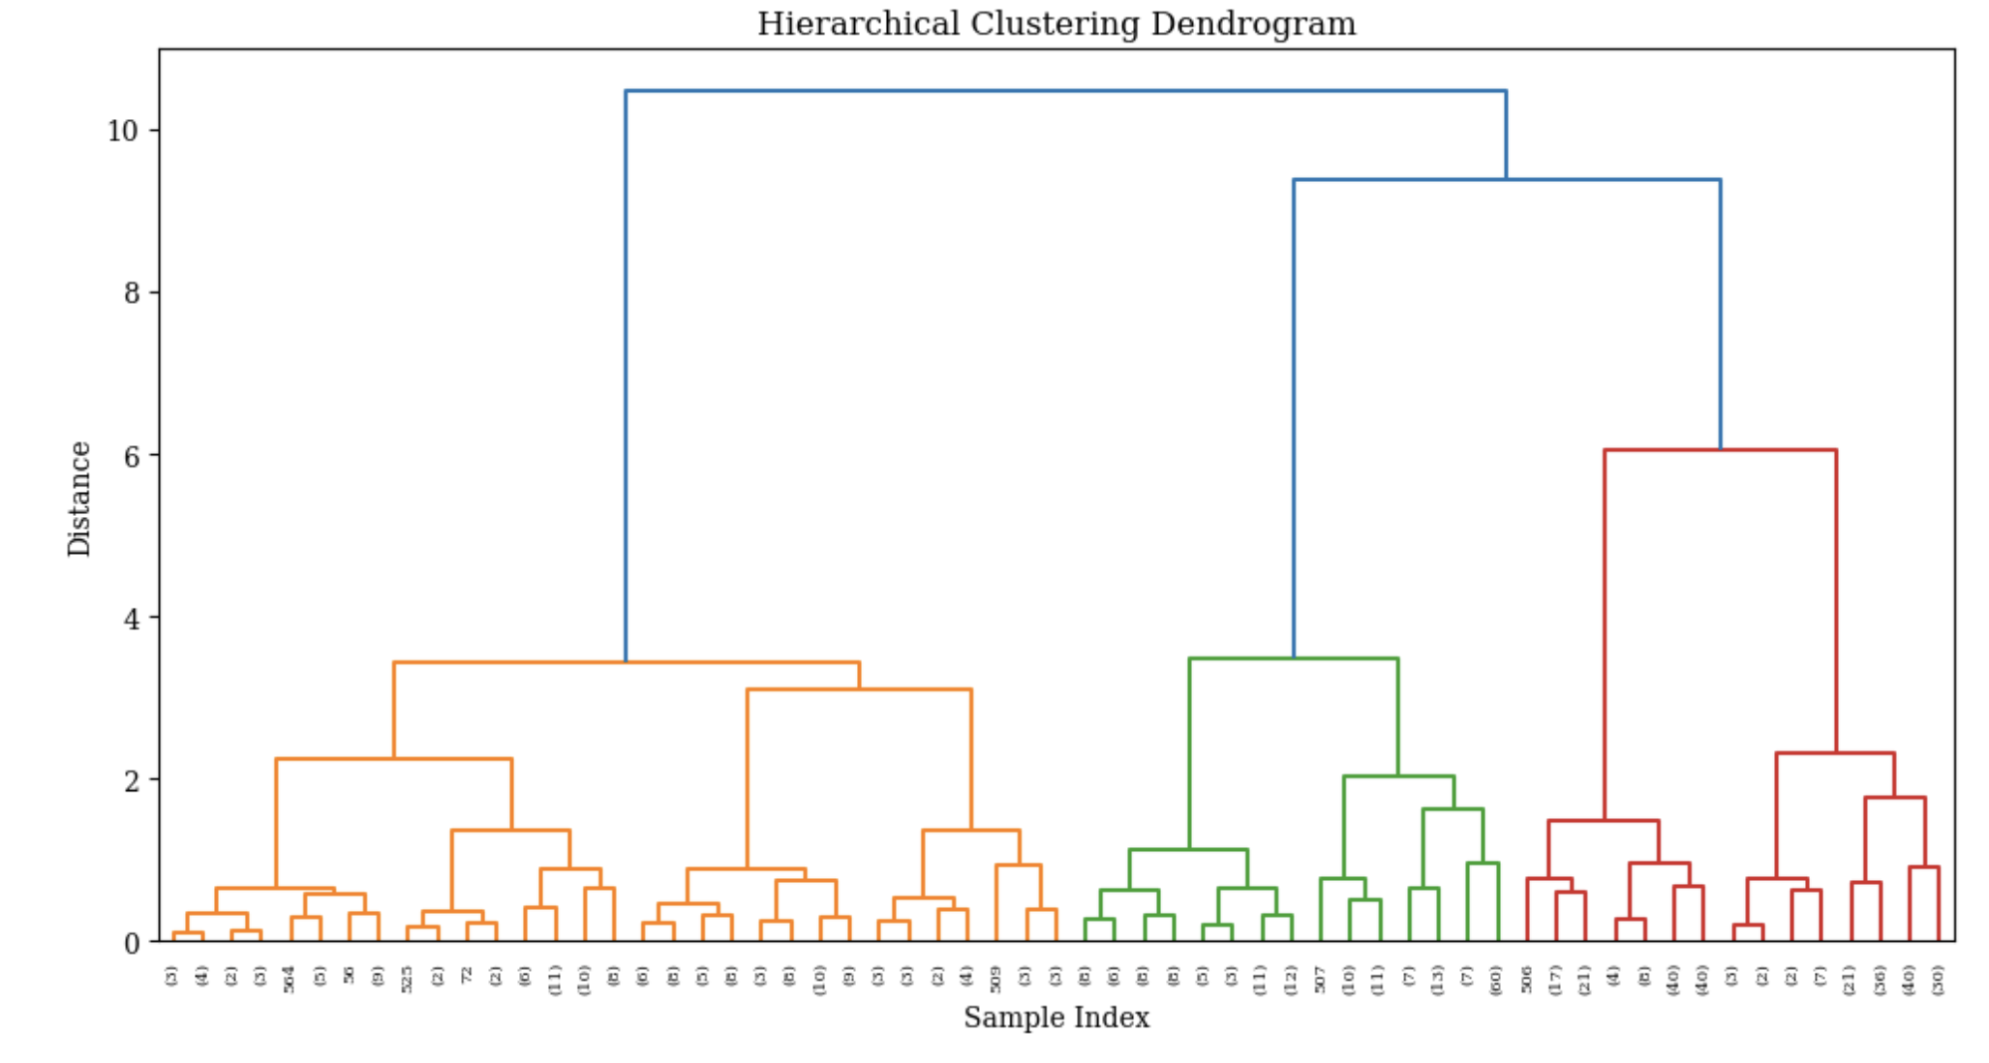
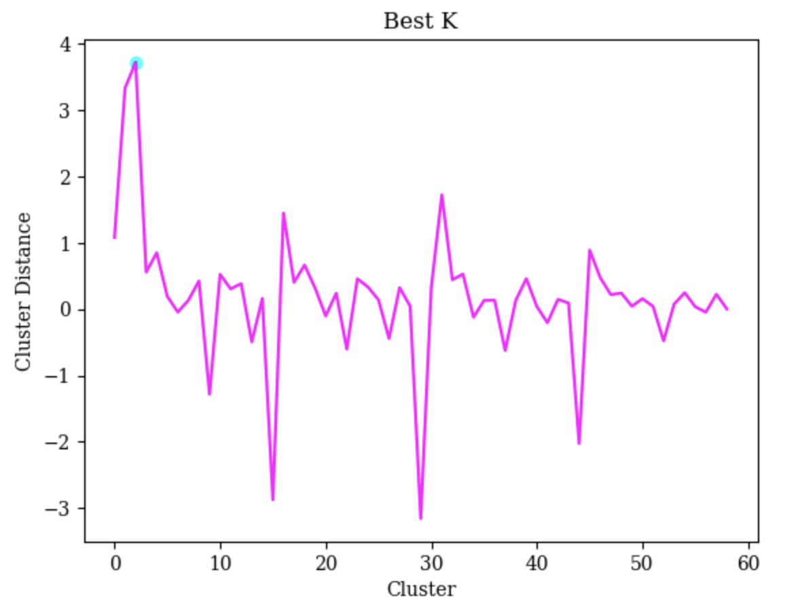
Determining K (agglom.)
What is a dendrogram?
Determining k
Plots the distance between each cluster when they are unified
Logically, clusters that are more real will have larger distances between each other, indicated by the y axis of the dendrogram
Create dendrogram, identify distances between each cluster
Plot the distances, find the max
Find the largest value of k close to the max (bias toward larger k)
In this case, k = 4.

Slide 13
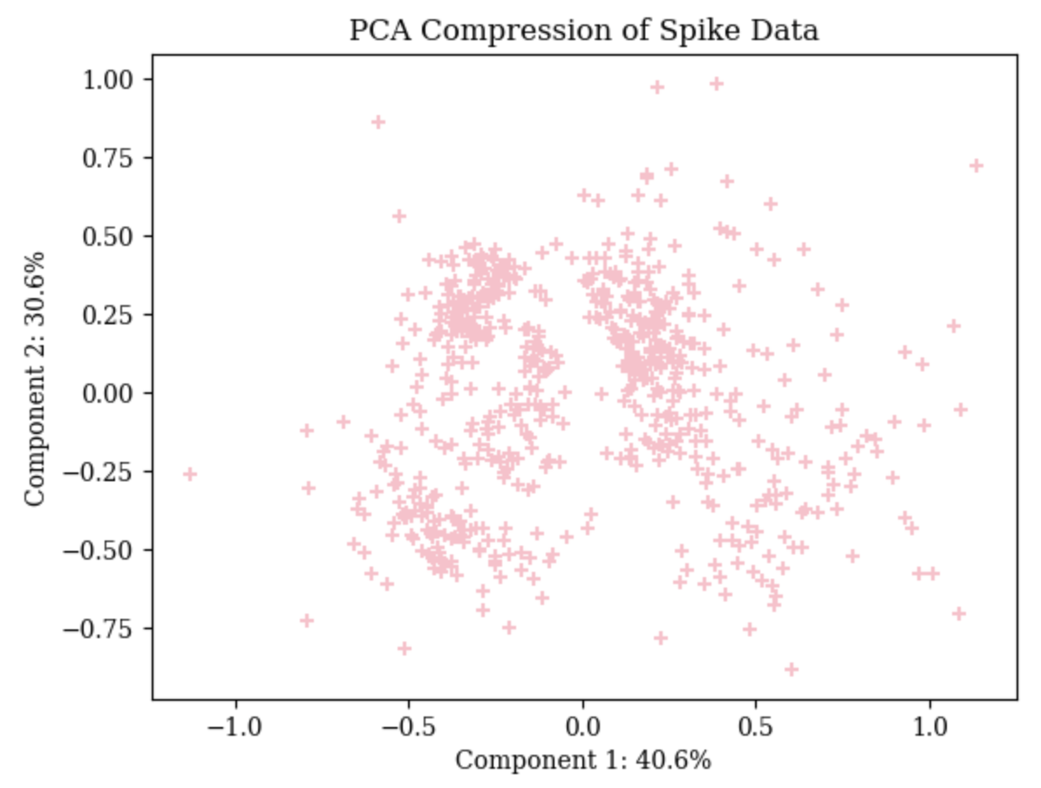
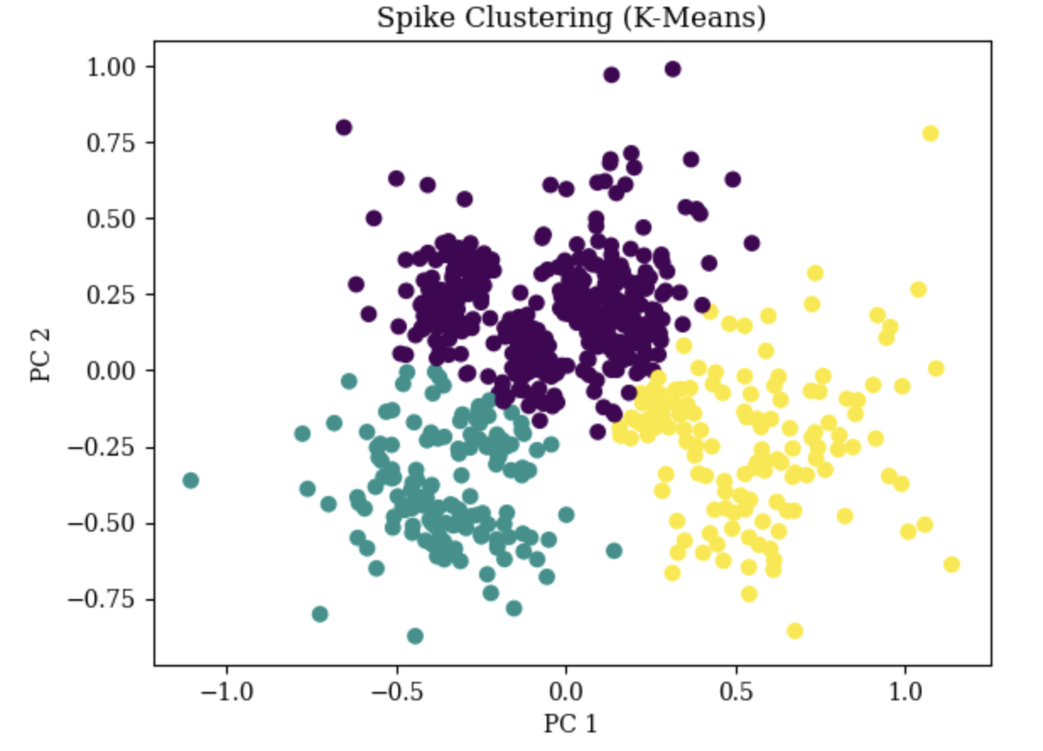
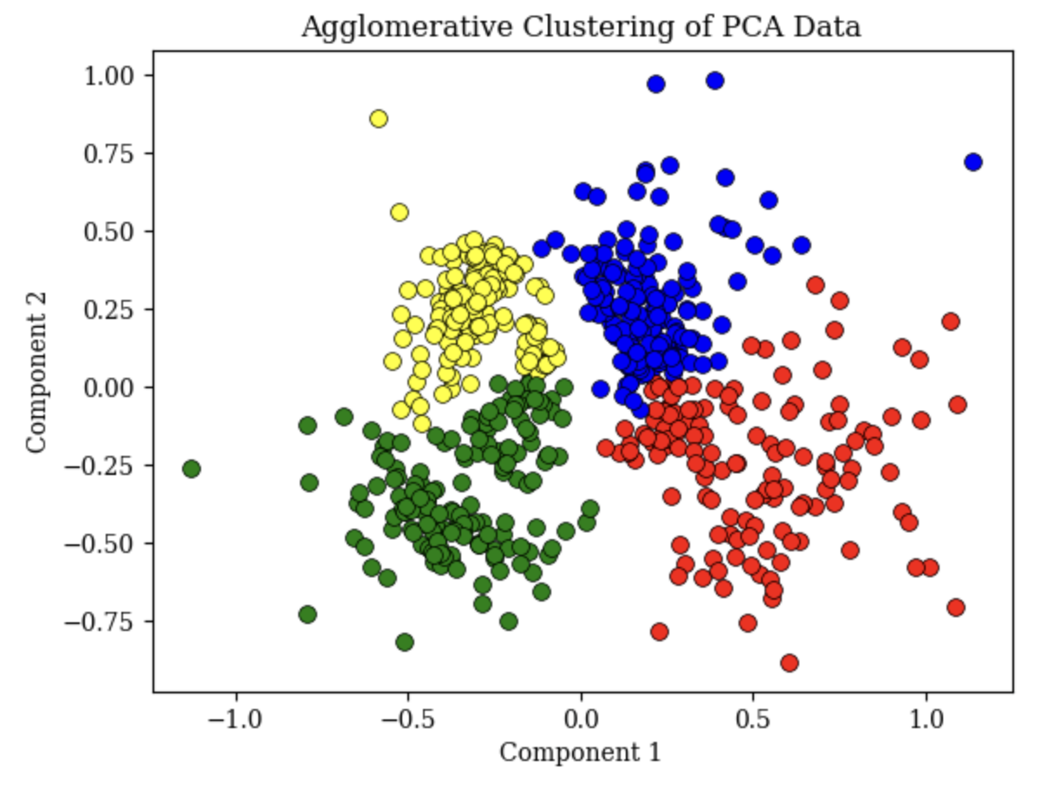
K-Means vs. agglomerative
Verdict: agglomerative

Slide 14
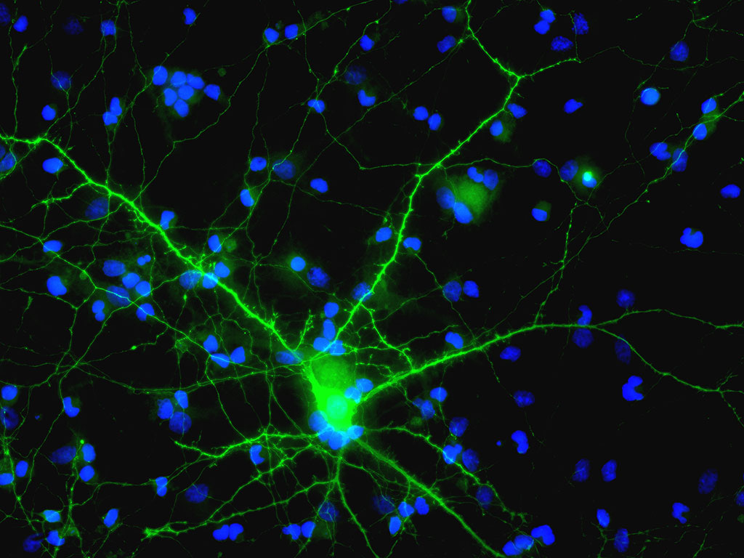
Results & Analysis

Slide 15
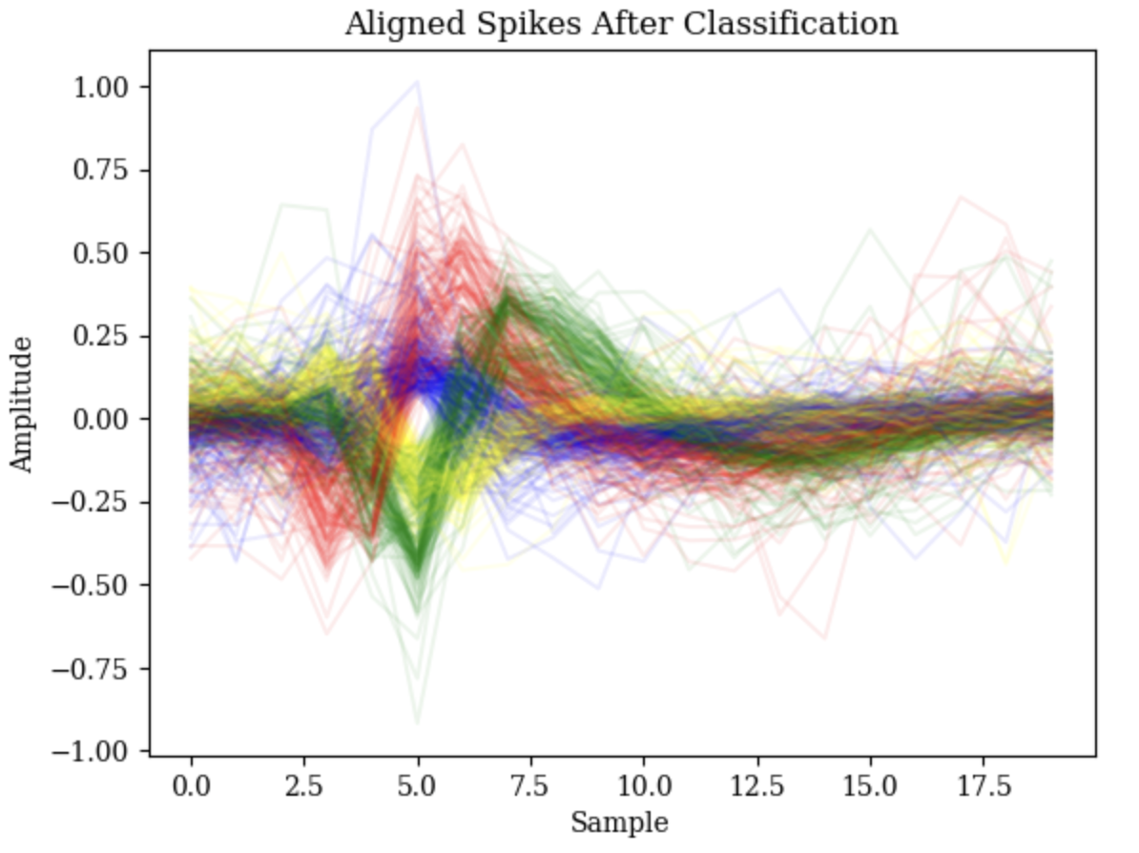
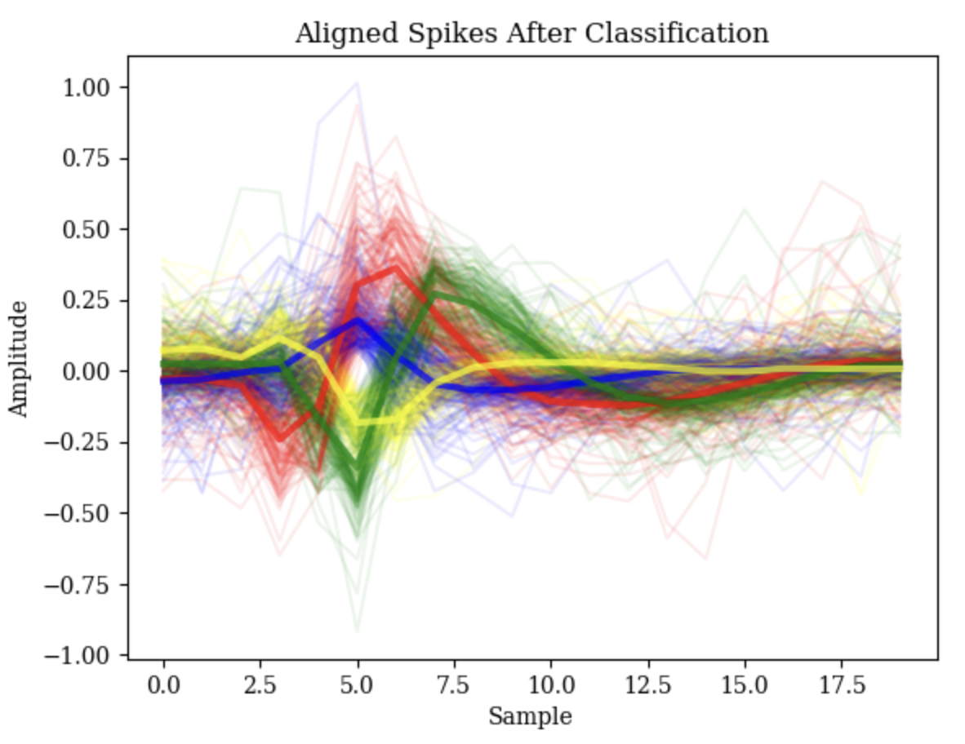
Spike classification

Slide 16
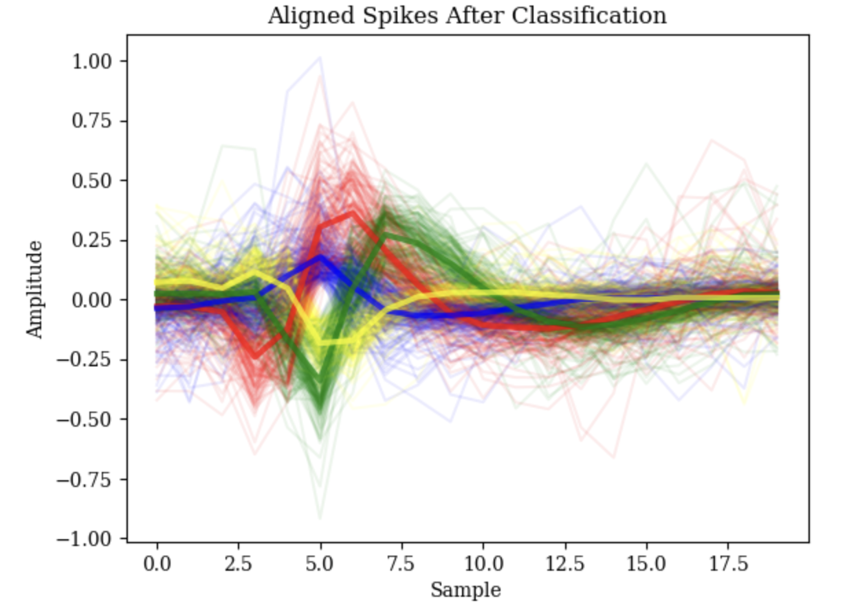
analysis
Spike Alignment
Classification does not appear too broad (many different waveforms of the same color)
Classification does not appear too narrow (many colors following the same waveform)
Red and green are probably the same waveform that were not aligned correctly
For decoding, it is better to classify one MUAP as two instead of classifying two different MUAPs as one

Slide 17
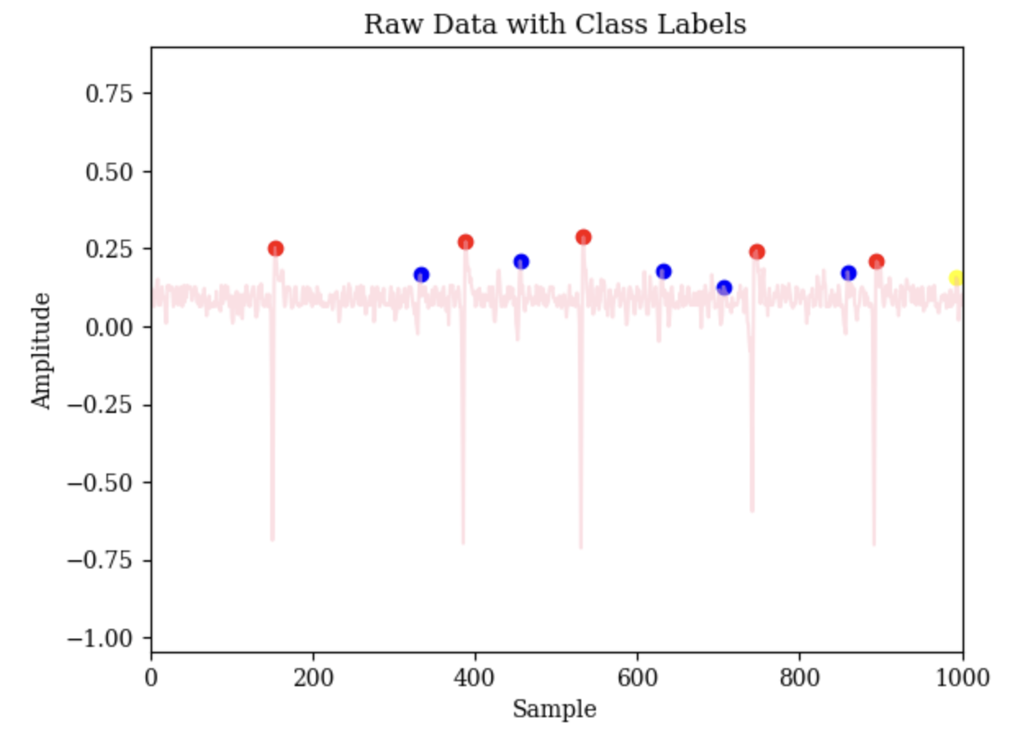
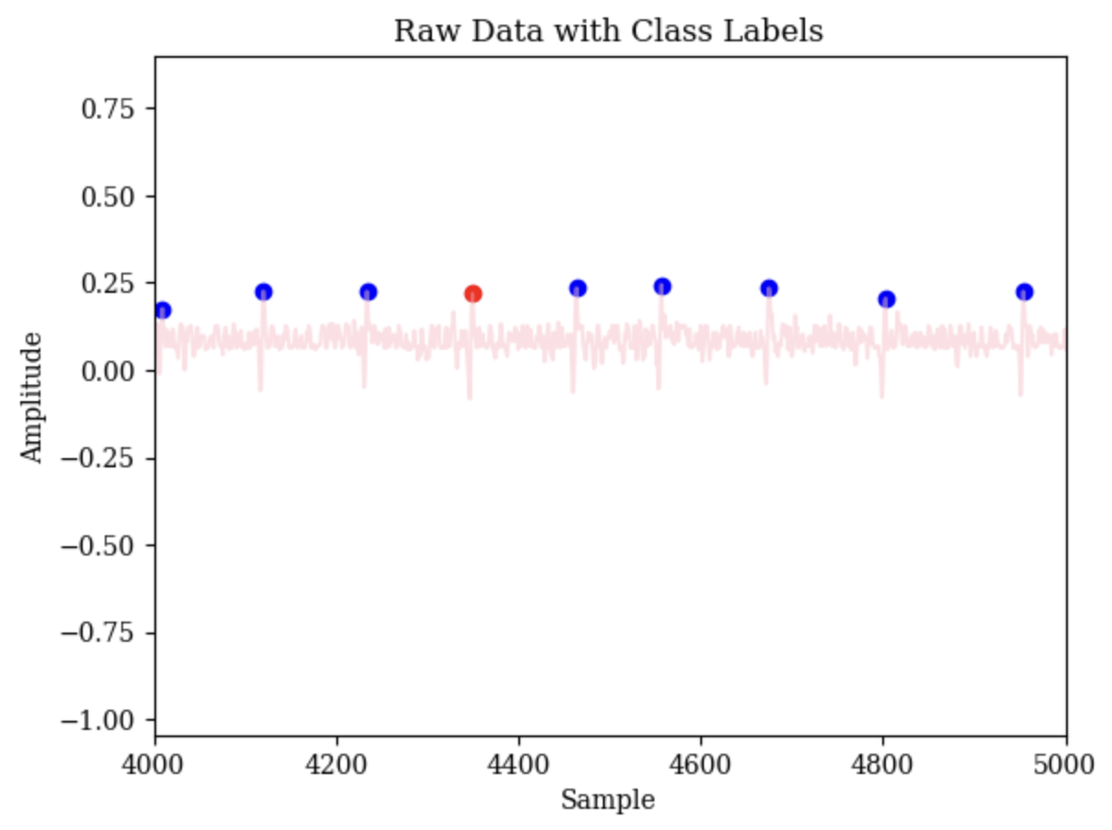
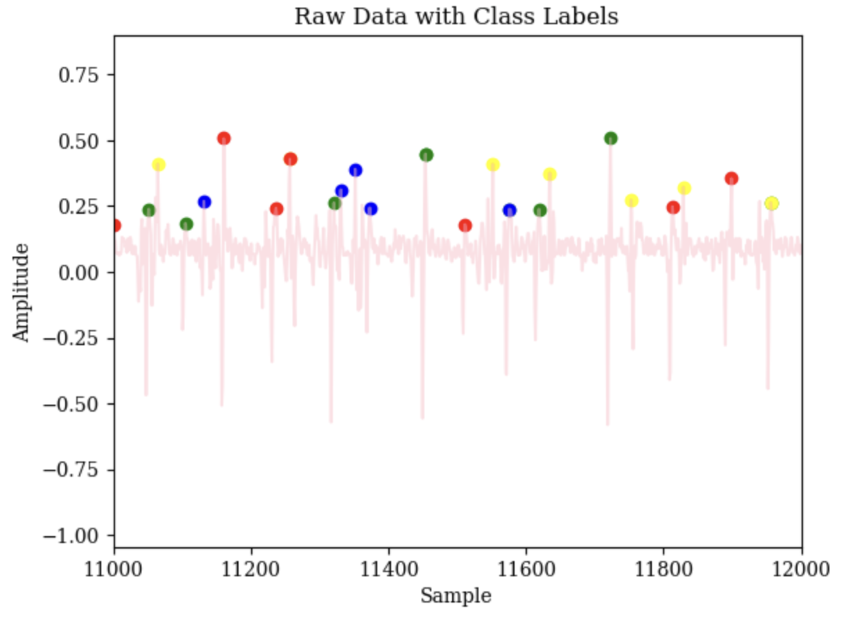
analysis
Raw Data
Top: large red spikes are not double-counted, which has previously been a problem
Middle: Blue spike likely erroneously as red spike
Bottom: Blurred distinction between red and green spikes, as well as unusual blue spikes.
Hard to visually distinguish small spikes from noise in raw data

Slide 18
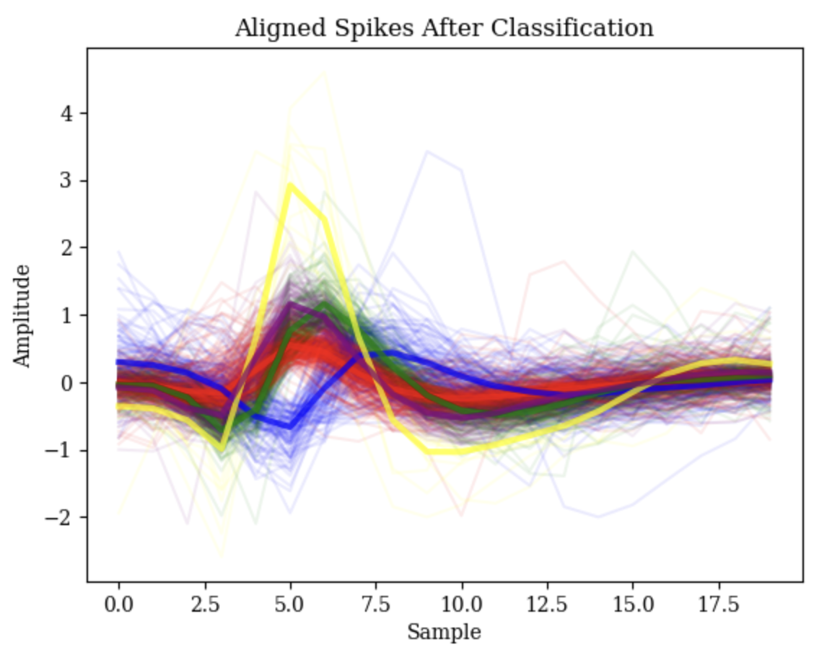
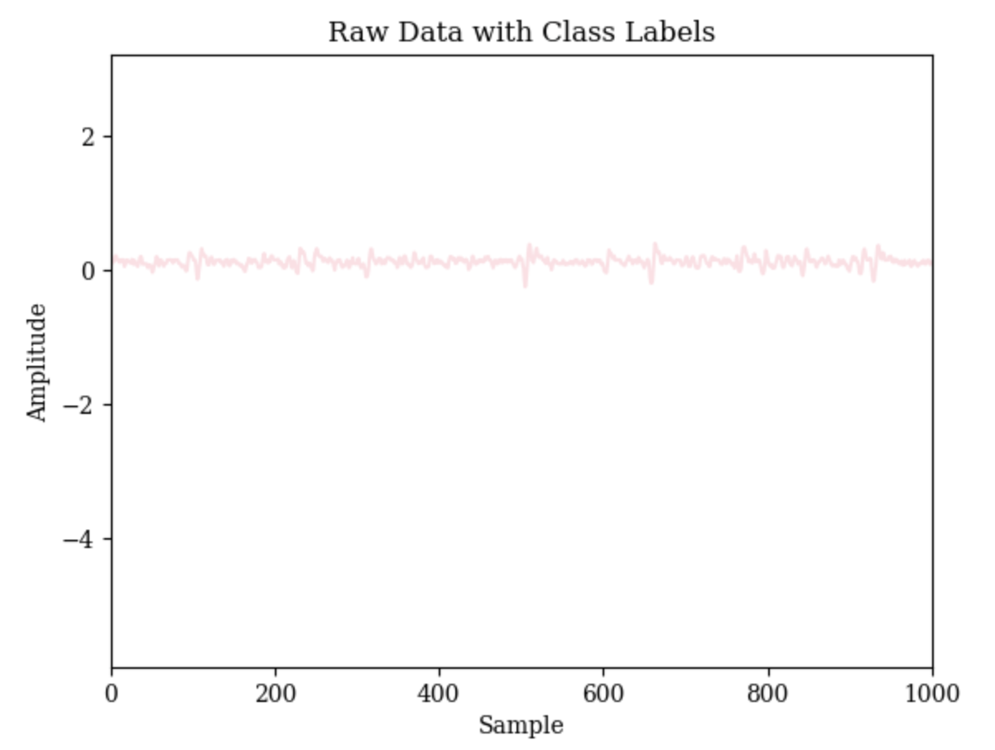
Analysis (channel 1)
K is too large (purposeful bias)
Red, green, and purple spikes are the same waveform
Yellow is a small number of outliers
Visible spikes that are not classified
Amplitude threshold was likely too high to include them
Difficult to find amplitude threshold that works for both files

Slide 19
Discussion
Strengths
Weaknesses
Clear and decipherable classification, as opposed to neural networks
Sensitivity to k, amplitude threshold, spike length/delay
Poor alignment in (green and red, channel 2)
Opportunities
Threats
Smarter NEO amplitude threshold calculation mechanism
Better alignment to avoid separating one waveform into multiple
Transferability from one channel/electrode to another

Slide 20
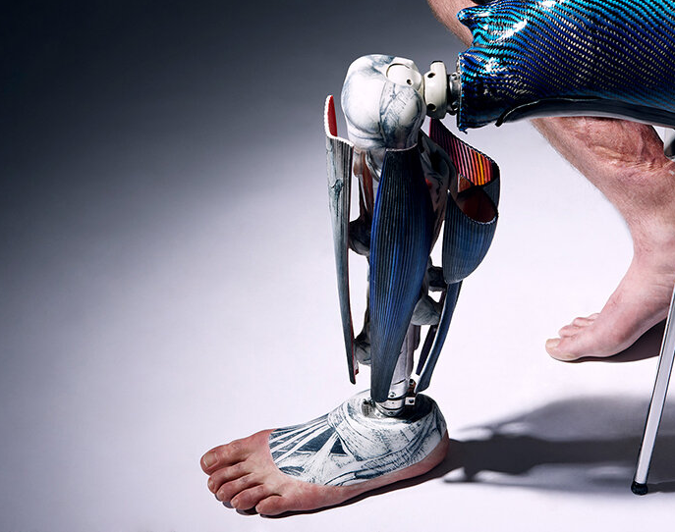
opportunities
Build more flexible algorithm to calculate accurate spike detection thresholds for many different electrode recordings
Use Fourier transform or spectral power instead of raw data to remove sensitivity to precise spike alignment
Instead of hard-coding a delay in between identified spikes to avoid double-counting, calculate correlations between spike classes to identify double counts
Provide opportunity for algorithm to combine classes that turn out to refer to the same waveform

Slide 21
Martin Bourdev UID: 205-491-049 UCLA Bioengineering M260 December 10, 2023
Thank
Thank
You
Thank you

